Slide 1
Python files
Non volatile storage

Slide 2
Storing data
So far, in all the programs we have created the data is stored in RAM
RAM is volatile
When the power is turned off, the data is lost
We will start to explore how to store data in files
Files are non-volatile, they remain when the power is turned off

Slide 3
Open, read, close
In this example, we will look at how to open a text file and read the contents
It is important that the file is closed after use
This is good memory management
The open() statement assigns a variable name to the file…
… tells the program where the file is located
… tells the program what the files name is
… tells the program what mode to open it in (read, write or append)

Slide 4
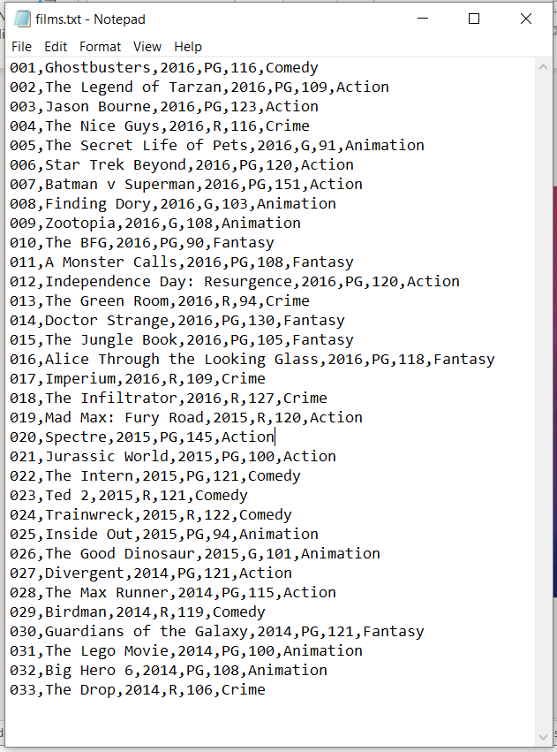

Slide 5
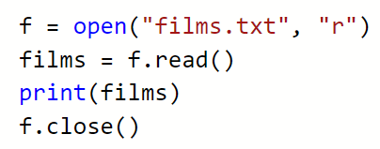
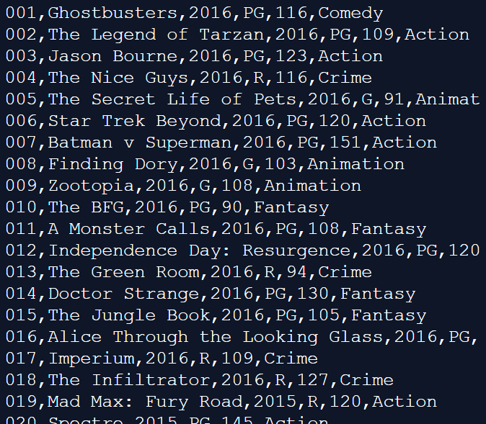
Where do you think this file is located?
r – read (why?)
w – write
rw – read & write

Slide 6
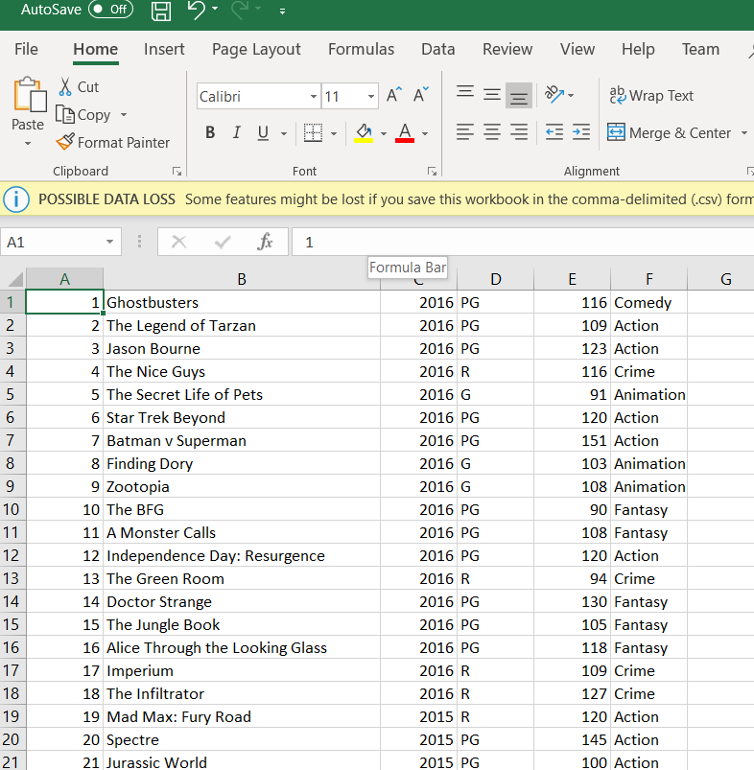

Slide 7
Readline()
We will expand the code by adding the readline() statement
This method will read one line from the file
The line is assigned to a variable
We can inspect each line and only print the data we want from the file

Slide 8
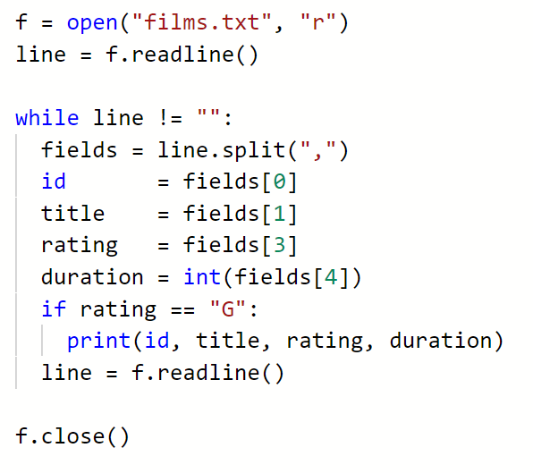
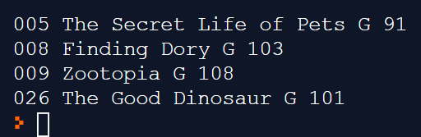

Slide 9
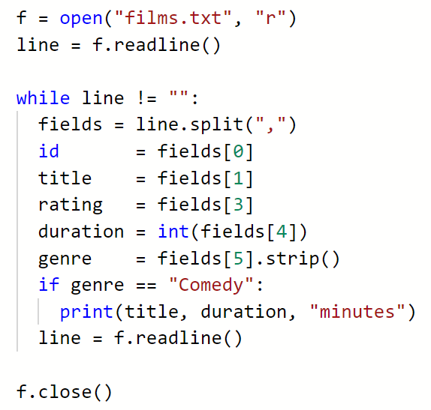
What will this code do?
Remove newline

Slide 10
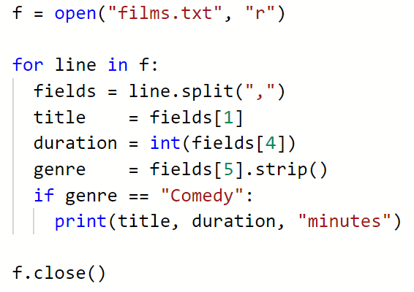
Using a for loop

Slide 11

Writing to a file
New files can be written to a file by opening in write mode:
We will look at this in more detail in our next lecture

Slide 12
activity
Produce the following programs
Read the file films.txt
Filter the output by genre, or date, or rating or length

